Slide 1
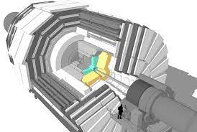

Improving close photons REsolution
in the CMS HGCAL detector
With Machine learning techniques
Stefano Veroni
Imperial College London
05/08/2022

Slide 2
Overview
CLUE3D Reconstruction
Key differentiating quantities
Ml Reconstruction
Stefano Veroni Page 2

Slide 3
HGCAL Overview
Stefano Veroni Page 3

Slide 4
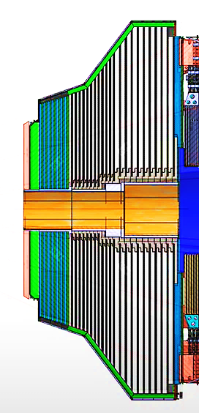
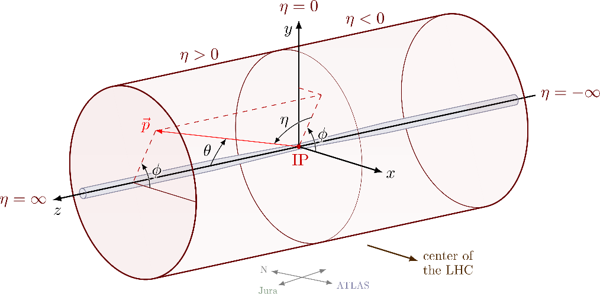



The High-granularity calorimeter
CE-H(B) - CE-H(F) - CE-E
Stefano Veroni Page 4

Slide 5

The data
Data (close-by photons) were simulated using the HGCAL software
Information was stored and analysed using CERN ROOT package in C++
Analysis was conducted at individual layer clusters (lcs) level
Stefano Veroni Page 5

Slide 6
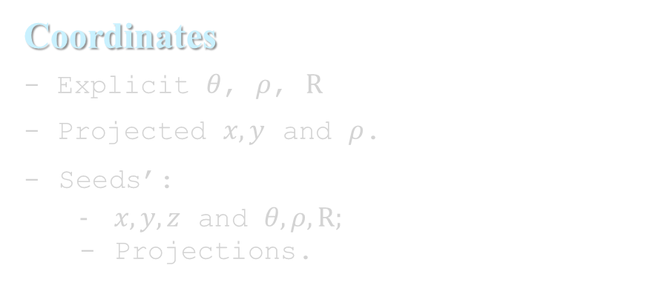
Root TtreEs Extra Information
Coordinates
- Explicit $θ$, $ρ$, $R$
- Projected $x, y$ and $ρ$.
Seeds’:
$x, y, z$ and $θ, ρ, R;$
Projections.
Deltas
Distances between 1°detections:
- Layer -wise
- LCs -wise
- Seeds -wise
- SimVertex -wise
- CPVertex -wise
Energies
Energy per layer
Layer # with maximum deposition
Barycenter Coordinates
(& Projected)
* For all, both per photon and total cases.
* Centre coordinates of layers with no lcs are set to unphysical values (x, y, z =1001, phi, eta, theta = 11).
Shape
Layer # with the most lcs.
Max Distances (lcs & from centre).
Area of ConvexHull of lcs.
Radii containing 68,90,95% of energy
* For all, both per photon and total cases.
**Distances & Areas have general and nrechits>=3 cases, and layer and projected cases.
(ShapeCore contains same data but $±4$ layers around core)
Stefano Veroni Page 6

Slide 7
General Considerations
Overlapping: 20-25 % of lcs are “shared”, i.e. attributed to both photons
Layer Clusters & Hits: at given energy, expect more lcs and hits for a di-photon shower.
Distances & Areas: di-photons shower involve larger distances and areas (both layer and projection –wise)
Energy Radii: Single showers are more likely to have large deviations. Otherwise distributions are similar for di-photons and single-photons showers. Exceptions: the 68% radius for combined events is on average quite larger. The 90% radius seems on average larger for single showers, but with very small values more common for the single. The 90/68 ratio appear much bigger in single-photon case.
Transverse characteristics depend on Energy. Loosely, a wide shower with many lcs can be the result of a large-energy single shower, or the combination of 2 photons’ showers.
However, 2 photons, say, with 50 GeV energy, starting a shower together, define a longitudinal shape which is different than the one of a 100 GeV photon, with different maximum and extension especially.
Stefano Veroni Page 7

Slide 8
CLUE3d Reconstruction
Stefano Veroni Page 8

Slide 9
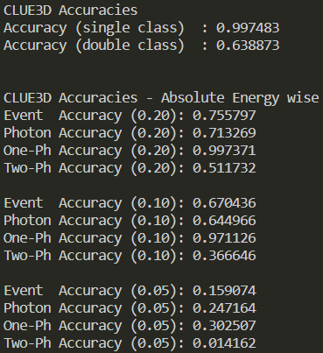
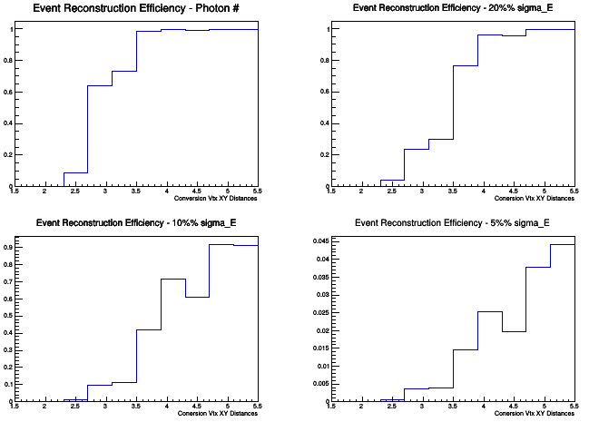
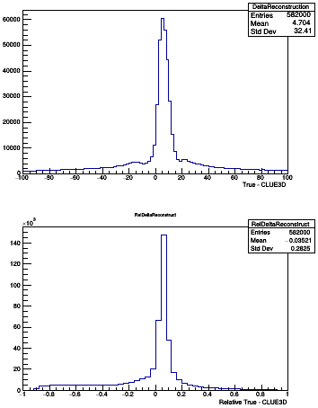


CLUE3D RECONSTRUCTION ACCURACY (Total Energy)
600,000 2-photons events with conversion vertices’ separation in (1.5, 5.5)cm
600,000 single-photons events
CLUE 3D
*Systematic errors due to lack of calibration
after application of selection criteria
Stefano Veroni Page 9

Slide 10
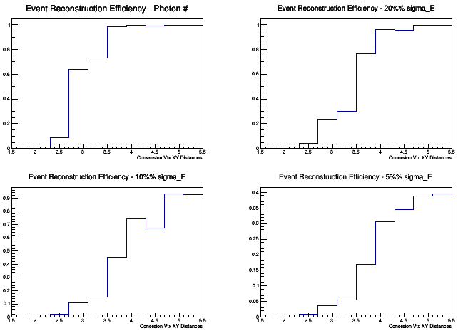
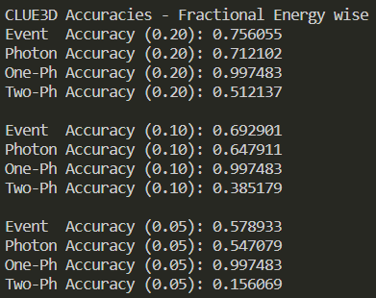
CLUE3D RECONSTRUCTION ACCURACY (Fractional Energy)
600,000 2-photons events with conversion vertices’ separation in (1.5, 5.5)cm
600,000 single-photons events
CLUE 3D
Stefano Veroni Page 10

Slide 11
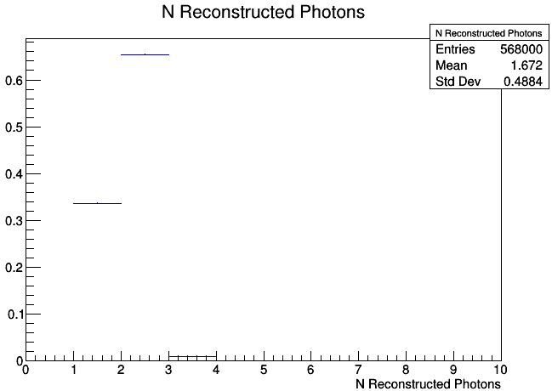
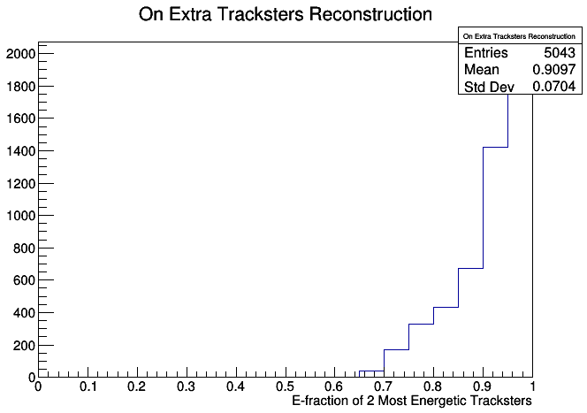
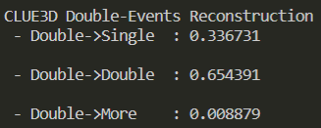
CLUE3D Extra-tracksters (from Double events)
Stefano Veroni Page 11

Slide 12

Key Quantities $$(E∈\left(95,105\right)GeV)$$
Stefano Veroni Page 12

Slide 13
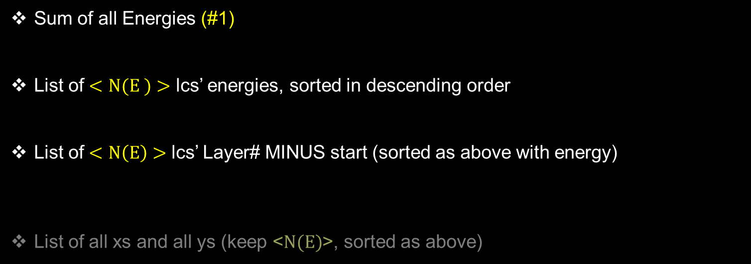
General Utilities – lcs info
Sum of all Energies (#1)
List of $<N(E )>$ lcs’ energies, sorted in descending order
List of $<N\left(E\right)>$ lcs’ Layer# MINUS start (sorted as above with energy)
List of all xs and all ys (keep <$N(E)$>, sorted as above)
Stefano Veroni Page 13

Slide 14
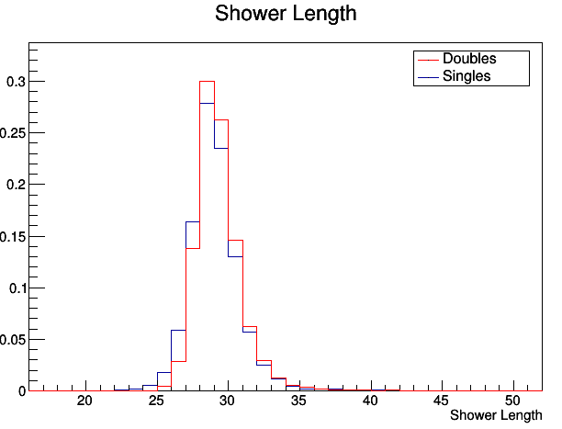
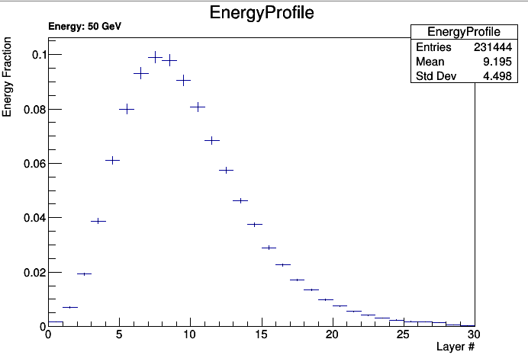
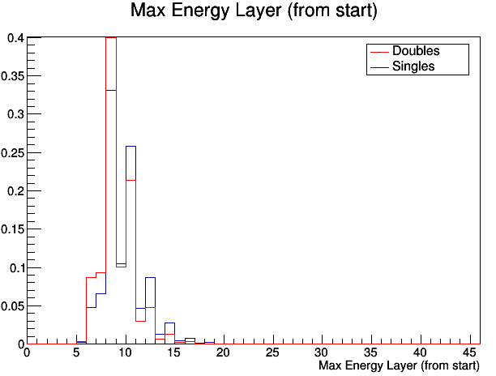
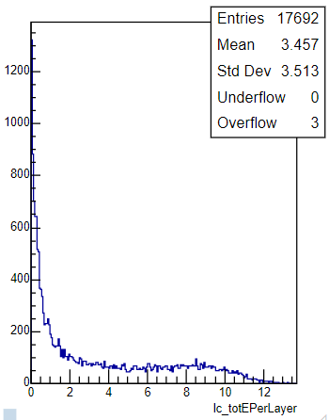
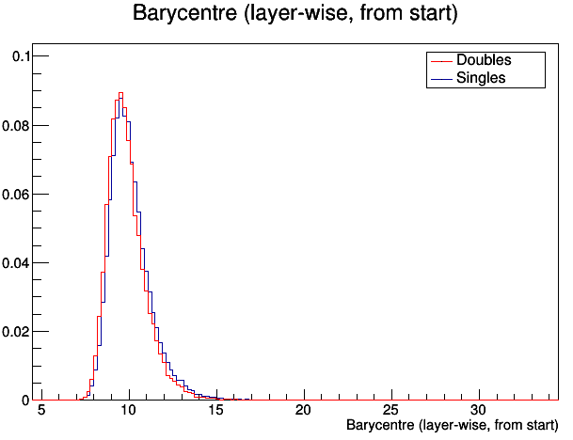
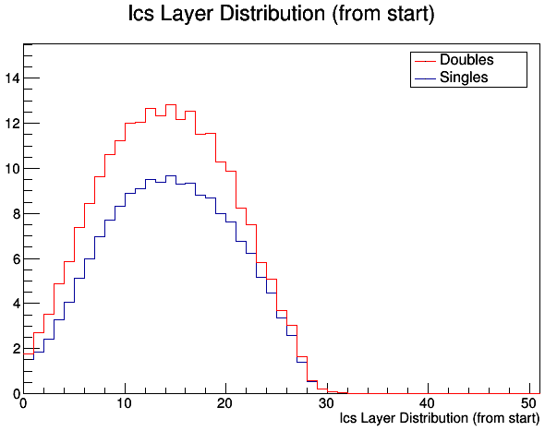
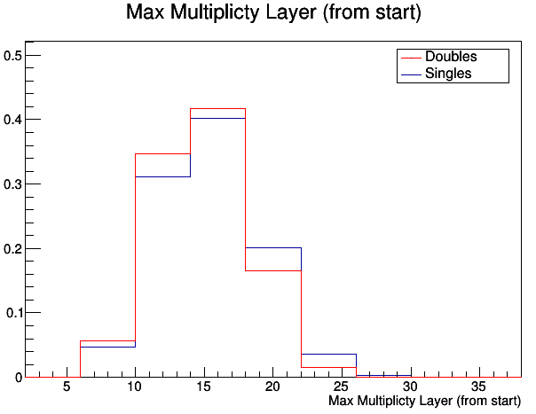


Key Quantities – Energy & Profile
#34/60
$$⇒$$
#1
#15/28
#1
$$⇒$$
#1
#15/28
#
#1
Stefano Veroni Page 14

Slide 15
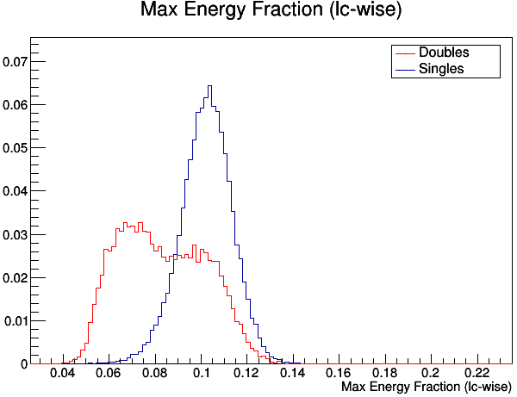
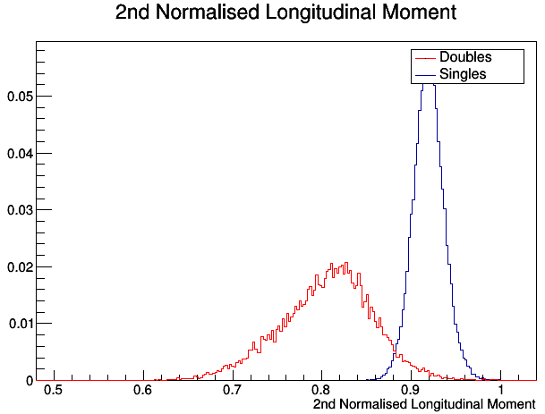
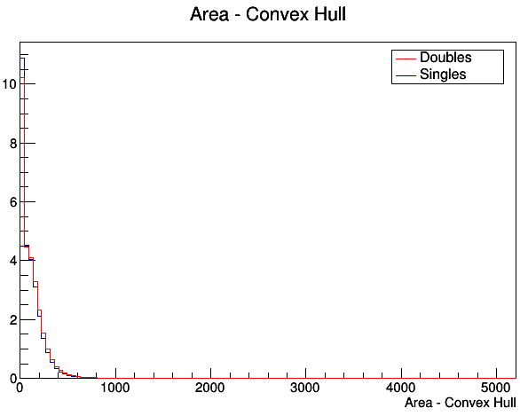
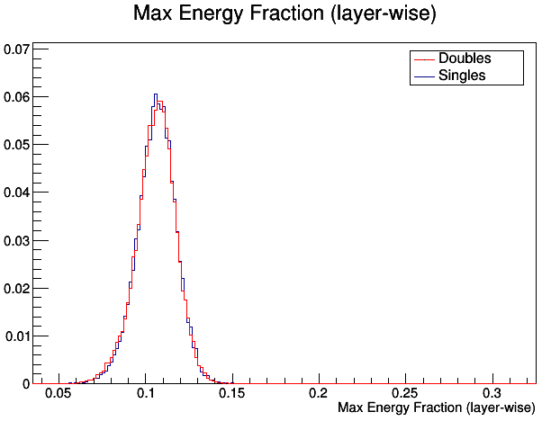
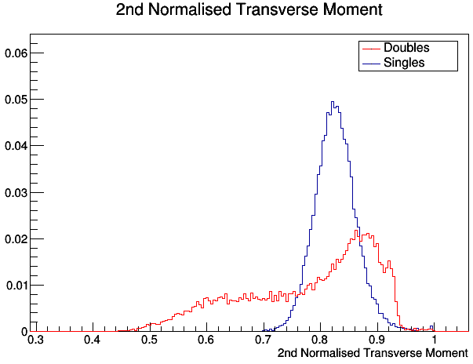
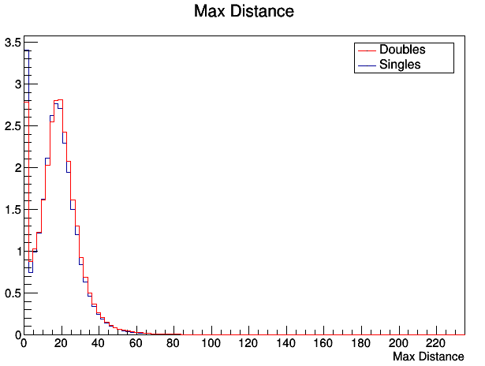
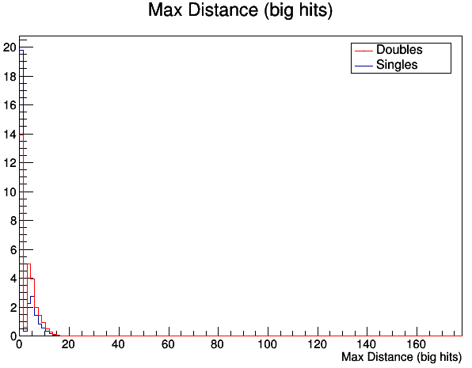
Key Quantities – # Photons
#34/60
#1
#1
#15/28
#1
#1
#15/28
Stefano Veroni Page 15

Slide 16
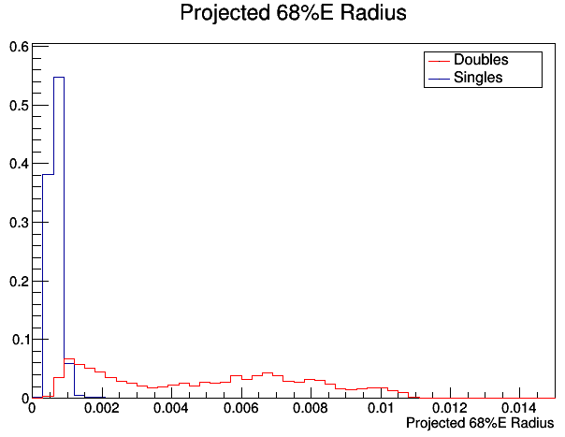
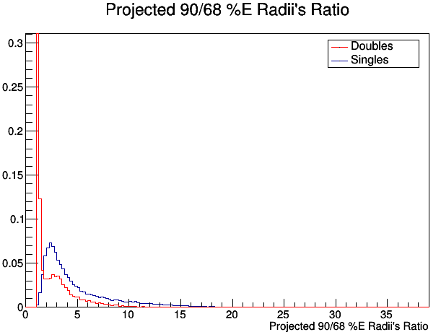
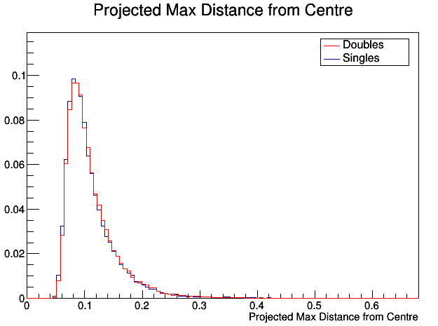
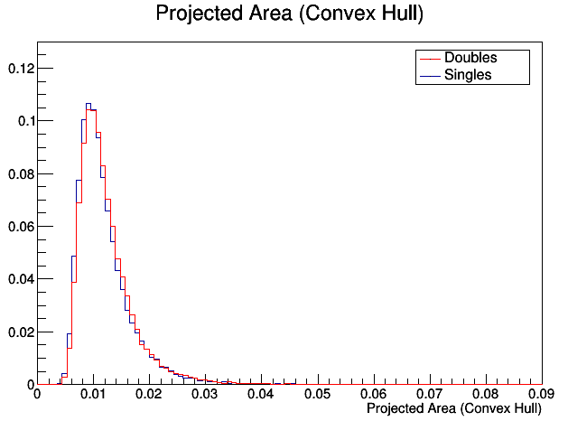
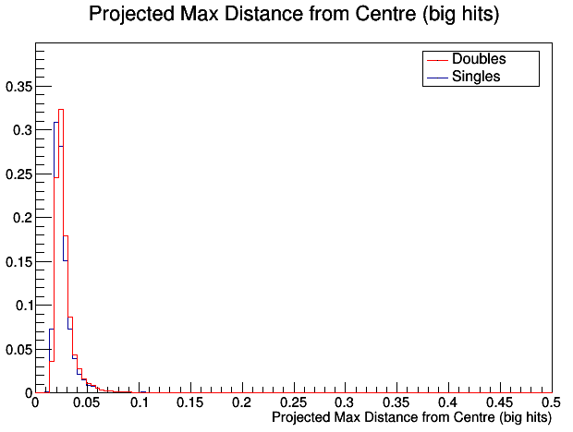
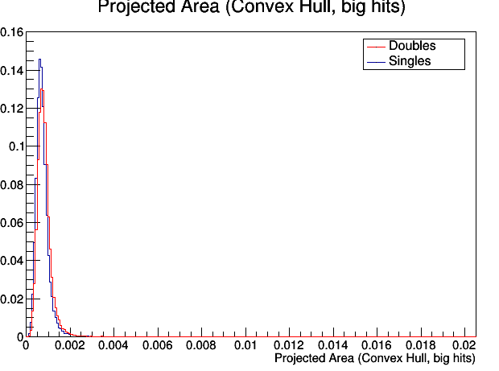
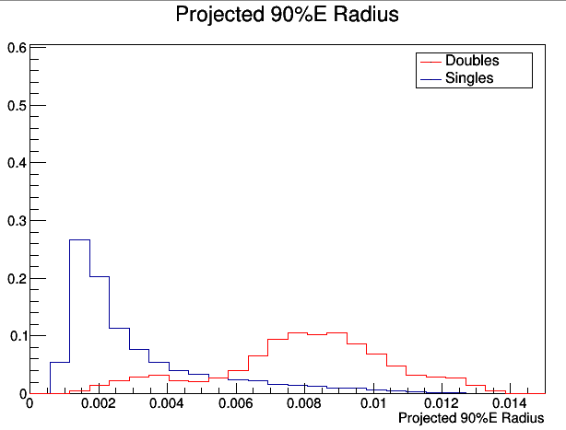
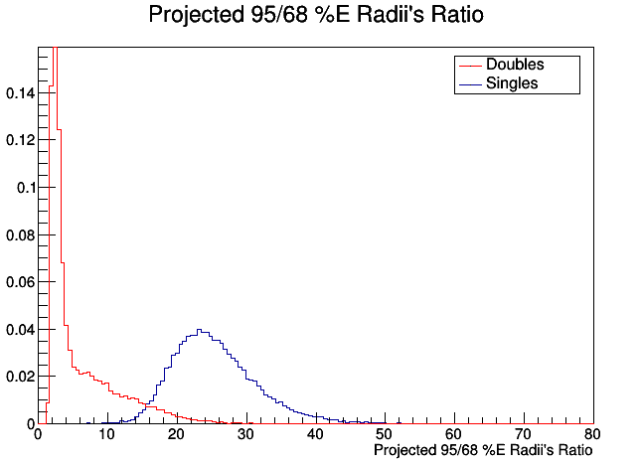
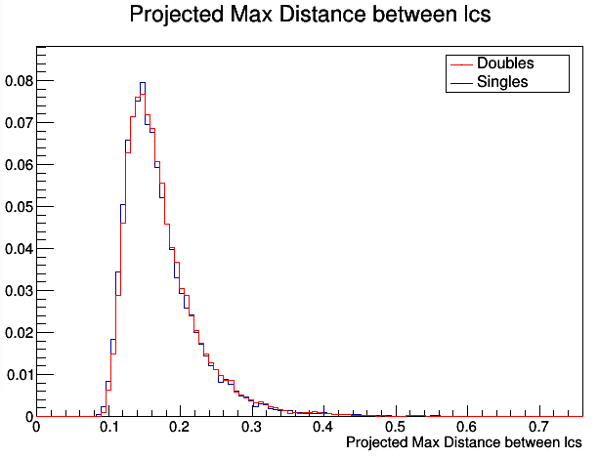
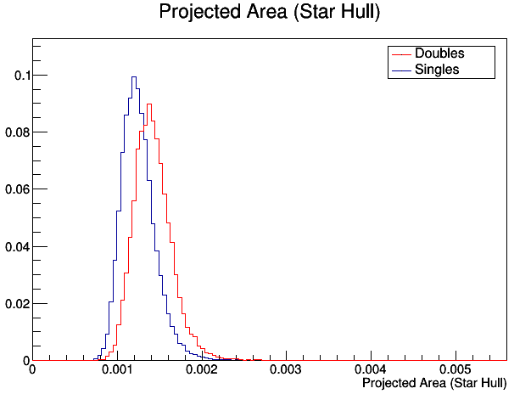
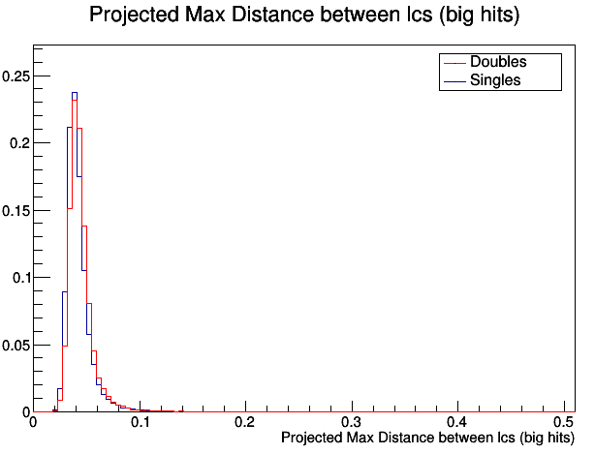
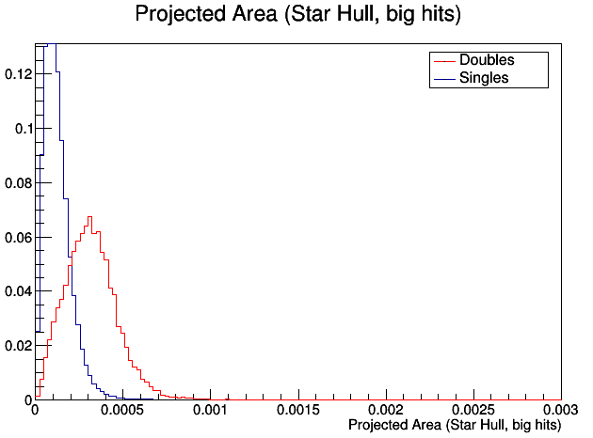
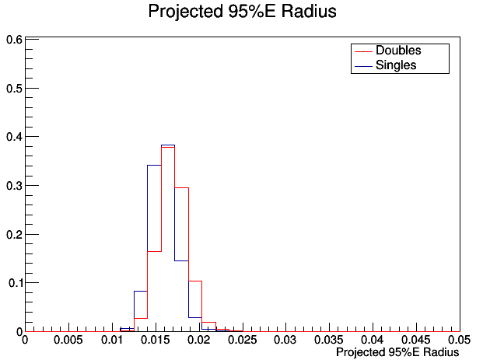
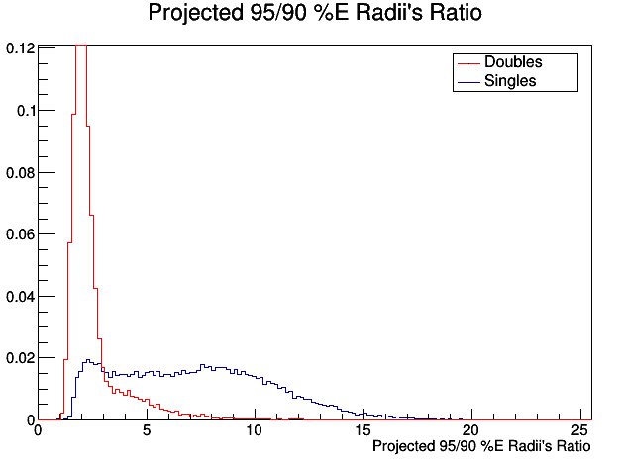
Key Quantities – # Photons (Projected)
#10
#1
#1
#1
#1
#1
#1
#1
#1
#1
#1
Stefano Veroni Page 16

Slide 17
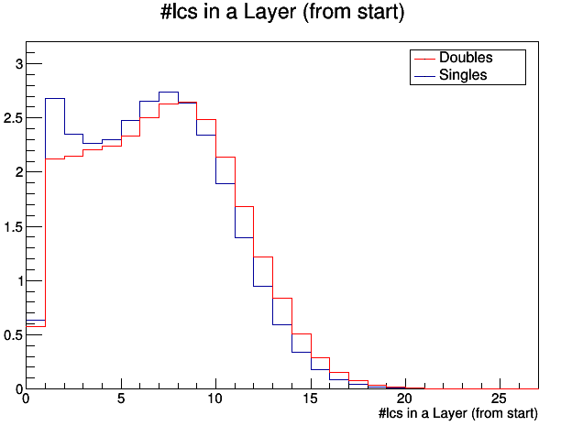
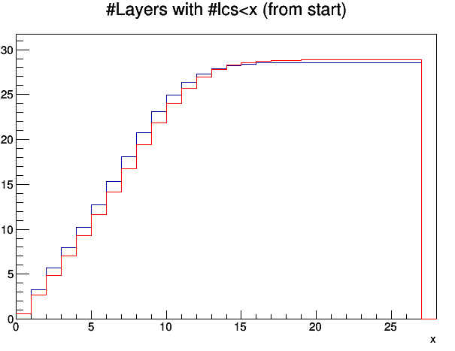
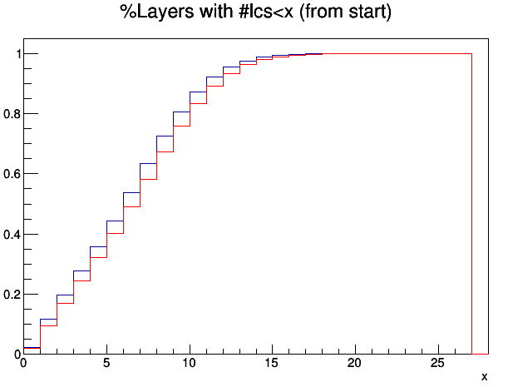
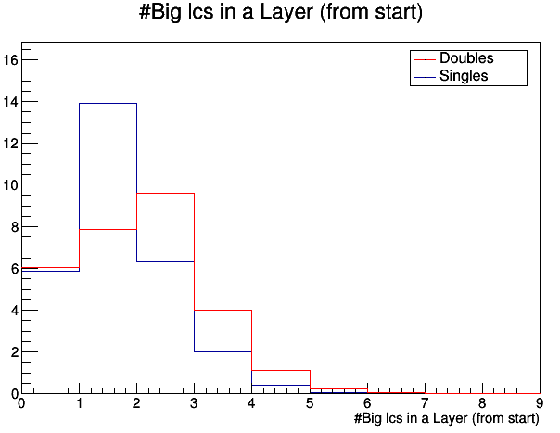
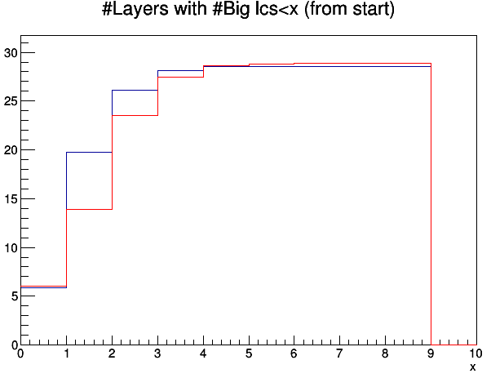

Key Quantities – E & $γ$
#30/56
#15/28
#15/28
Stefano Veroni Page 17

Slide 18
Machine learning reconstruction
Stefano Veroni Page 18

Slide 19
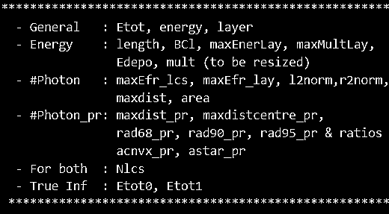
Classification - Machine Learning
Feed ML model with Inputs:
I. Boosted Decision Trees
(XGBoost)
II. Neural Network (PyTorch)
1 Output Regression:
Most energetic photon’s E fraction
Classification + Regression:
Class
Most energetic photon E fraction
4 Outputs Regression/Class+Regress
- Scores associated with 1/2 photon(s)
- Fractions of energy of 2 photons
Stefano Veroni Page 19

Slide 20
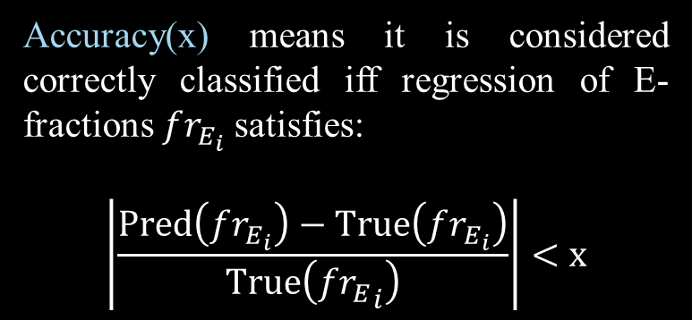
Notes on accuracy Terminology
Accuracy( <type> class) means:
- it only considers type <type> events;
- only classification of the event matters, not regression of photon(s)’ E-fractions.
Event Accuracy(x): all photons in the event are simultaneously correctly reconstructed up to x threshold
Photon Accuracy(x) : all photons are considered separately.
One-Ph Accuracy (x) : Event Accuracy(x) of single photon events only.
Two-Ph Accuracy (x) : Event Accuracy(x) of double events only.
Accuracy(x) means it is considered correctly classified iff regression of E-fractions $fr_{E_{i}}$satisfies:
$$\left|\frac{\operatorname{Pred}\left(fr_{E_{i}}\right)−True\left(fr_{E_{i}}\right)}{True\left({{fr}_{E}}_{i}\right)}\right|<x$$
Stefano Veroni Page 20

Slide 21
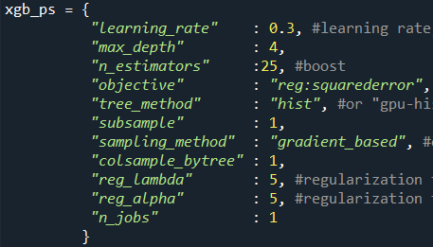
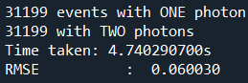



















1 Output Regression: XGB-RegressoR (pre-selection info, i.e. with advantage over clue3d)
*Accuracy (x) means
$$\left|\frac{\operatorname{Pred}\left(fr_{E_{i}}\right)−True\left(fr_{E_{i}}\right)}{True\left({{fr}_{E}}_{i}\right)}\right|<x$$
$E_{T}<100 GeV$
$100<E_{T}<200 GeV$
$$200<E_{T}<400 GeV$$
$All info$ (100lcs)
$$No lcs info$$
$All info$ (150lcs)
$$No lcs info$$
$All info$ (200 lcs)
$$No lcs info$$
Stefano Veroni Page 21

Slide 22


























XGB Classification + regression
(pre-selection info, i.e. with advantage over clue3d)
*Accuracy (x) means
$$\left|\frac{\operatorname{Pred}\left(fr_{E_{i}}\right)−True\left(fr_{E_{i}}\right)}{True\left({{fr}_{E}}_{i}\right)}\right|<x$$
$E_{T}<100 GeV$
$100<E_{T}<200 GeV$
$$200<E_{T}<400 GeV$$
$All info$ (100lcs)
$$No lcs info$$
$All info$ (150lcs)
$$No lcs info$$
$All info$ (200lcs)
$$No lcs info$$
Stefano Veroni Page 22

Slide 23














XGB Classification + regression
(Post-SElection info, i.e same level as clue3d)
*Accuracy (x) means
$$\left|\frac{\operatorname{Pred}\left(fr_{E_{i}}\right)−True\left(fr_{E_{i}}\right)}{True\left({{fr}_{E}}_{i}\right)}\right|<x$$
$E_{T}<100 GeV$
$100<E_{T}<200 GeV$
$$200<E_{T}<400 GeV$$
$All info$ (100lcs)
$$No lcs info$$
$All info$ (150lcs)
$$No lcs info$$
$All info$ (200lcs)
$$No lcs info$$
Stefano Veroni Page 23

Slide 24









XGB Classification + regression
(Trigger-witH info)
$E_{T}<100 GeV$
$100<E_{T}<200 GeV$
$$200<E_{T}<400 GeV$$
Stefano Veroni Page 24

Slide 25




XGB Classification + regression
(Trigger-witH info)
*Note: 3 Energy cases equally weighted, independently of number of events
Stefano Veroni Page 25

Slide 26

Conclusion
After examining showers, the following quantities
Compared to CLUE3D:
for Classification:
Singles Accuracy decreased by 0.4% (0.997 → 0.993);
Doubles Accuracy increased by 33.0% (0.639 → 0.969);
for Regression:
Doubles 20%-Accuracy increased by 35% (0.51 → 0.86);
Doubles 10%-Accuracy increased by 29% (0.39 → 0.68);
Doubles 5%-Accuracy increased by 27% (0.16 → 0.43);
Average Time Taken (on my 8GB-RAM & 3years old laptop)
Classification: $2.6±1.6 μs$ per event
Regression : $1.6±0.2 μs$ per event
⇒
were selected to be fed to XGBoost Decision trees in a combination of Classifier + Regressor.
Further Work Suggestions
Further careful tuning of XGB parameters can improve model’s accuracy;
Other ML techniques, such as Neural Networks for instance, could use the individuated quantities to achieve even higher accuracy, if well built.
Implementation Suggestions
The presented technique could, perhaps, be involved in:
“on the fly” corrections to data classification, if fast enough;
2nd stage analyses, in particular on “dubious” events.
Stefano Veroni Page 26

Slide 27
References
[1]CMS Collaboration. The Phase-2 Upgrade of the CMS endcap calorimeter; Technical Design Report. 2018.
Available from https://cds.cern.ch/record/2293646/files/CMS-TDR-019.pdf
[2] Bichsel H, Groom DE, Klein SR. Passage of Particle through Matter. Jan 2010.
Available from https://pdg.lbl.gov/2011/reviews/rpp2011-rev-passage-particles-matter.pdf
[3] HGCAL Website. Available from https://hgcal.web.cern.ch/.
[4] Brun R, Rademakers F. ROOT - An Object Oriented Data Analysis Framework, Proceedings AIHENP'96 Workshop, Lausanne, Sep. 1996, Nucl. Inst. & Meth. in Phys. Res. A 389 (1997) 81-86. Software available from https://root.cern/.
[5] Rovere M, Chen Z, Di Pilato A, Pantaleo F, Seez C. CLUE: A Fast Parallel Clustering Algorithm for High Granularity Calorimeters in High Energy Physics. 2020.
Available from https://arxiv.org/abs/2001.09761.
[6] ATLAS Collaboration. Electron performance measurements with the ATLAS detector using the 2010 LHC proton-proton collision data. Eur. Phys. Journ. C. Mar 2012. ) 72:1909.Available from https://link.springer.com/content/pdf/10.1140/epjc/s10052-012-1909-1.pdf.
[7]Nehuhaus F, Choliz ER, Schott M. Detection of collinear high energetic di-photon signatures with Micromegas Detectors. 2021.
Available from https://arxiv.org/pdf/2111.14939.pdf.
[8] Chen T, Guestrin C. XGBoost: A Scalable Tree Boosting System. In: Proceedings of the 22nd ACM SIGKDD International Conference on Knowledge Discovery and Data Mining [Internet]. New York, NY, USA: ACM; 2016. p. 785–94.
Available from: http://doi.acm.org/10.1145/2939672.2939785.
[9] Pedregosa F, et al. Scikit-learn: Machine Learning in Python. Journal of Machine Learning Research 2011. 12. p. 2825 – 2830.
[10] Paszke A, Gross S, Massa F, Lerer A, Bradbury J, Chanan G, et al. PyTorch: An Imperative Style, High-Performance Deep Learning Library. In: Advances in Neural Information Processing Systems 32 [Internet]. Curran Associates, Inc.; 2019. p. 8024–35.
Available from: http://papers.neurips.cc/paper/9015-pytorch-an-imperative-style-high-performance-deep-learning-library.pdf.
Stefano Veroni Page 27

Slide 28
Appendix A PRELIMINARY LOOK AT JUST DELTASV = 3CM Results in testing nn architectures

Slide 29






























4 Outputs Regression: Neural Network ($Delta_{sv}$ $fixed to 3 cm, E_{T}<100 GeV$)
$Not Balanced Data, 100lcs$
$Balanced Data, 100lcs$
$$Balanced Data, no lcs info$$
Original Input
Normalised Input

Slide 30

























4 Outputs Regression: Neural Network ($Delta_{sv}$ $fixed to 3 cm, 100<E_{T}<200 GeV$)
$Not Balanced Data, 150lcs$
$Balanced Data, 150lcs$
$$Balanced Data, no lcs info$$
Original Input
Normalised Input
Normalised Input

Slide 31



















4 Outputs Regression: Neural Network ($Delta_{sv}$ $fixed to 3 cm, 200<E_{T}<400 GeV$)
$Not Balanced Data, 200lcs$
$Balanced Data, 200lcs$
$$Balanced Data, no lcs info$$
Original Input
Normalised Input

